Slide 1
AGRICULTURAL MACHINE CLOUD

Slide 2
TEAM
Submitted by Team 13:
Submitted to Prof. Jerry Gao
TEAM MEMBER | COMPONENT/ ROLE
Aditi Khurd | Database Design
Parineeta Kishore Patil | Sensors & Cloud Deployment
Saikumar Reddy Sandannagari | UI + Dashboard
Siddarth Varanasi | APIs/ Backend for UI

Slide 3
Agenda
Introduction & motivation
Requirements and implementation
Infrastructure and architecture
Cloud architecture and implementation
Business model

Slide 4
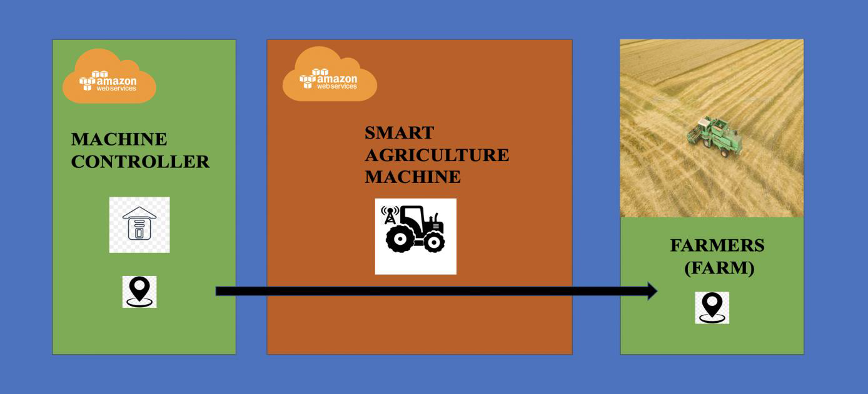
Overview
A Cloud-Based Agriculture Machine Service Platform (AG-Machine-Cloud) is a system designed for transportation of agricultural products. The goal of the system is to maintain flexibility, safety and affordability.

Slide 5
Motivation
Agriculture is one of the largest sectors in the United States. About 40% of US land is used for agriculture.
Research demonstrates that farmers and ranchers receive only 15 cents out of every dollar spent on food at home and abroad. The rest is required for processing, marketing, materials for production, distribution and transportation.
Hence, a system with reasonable rates as well as access is required for the transportation of agricultural products.

Slide 6
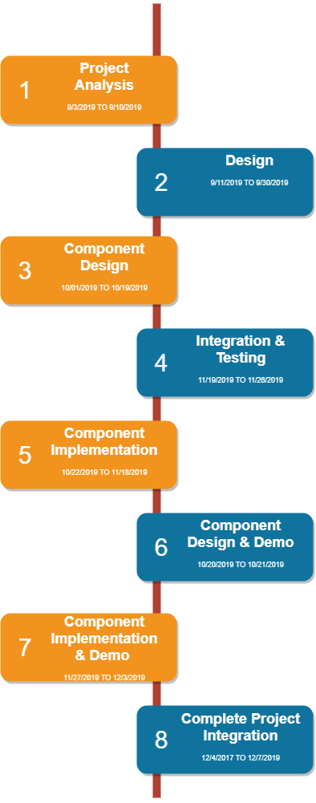
Plan of action

Slide 7
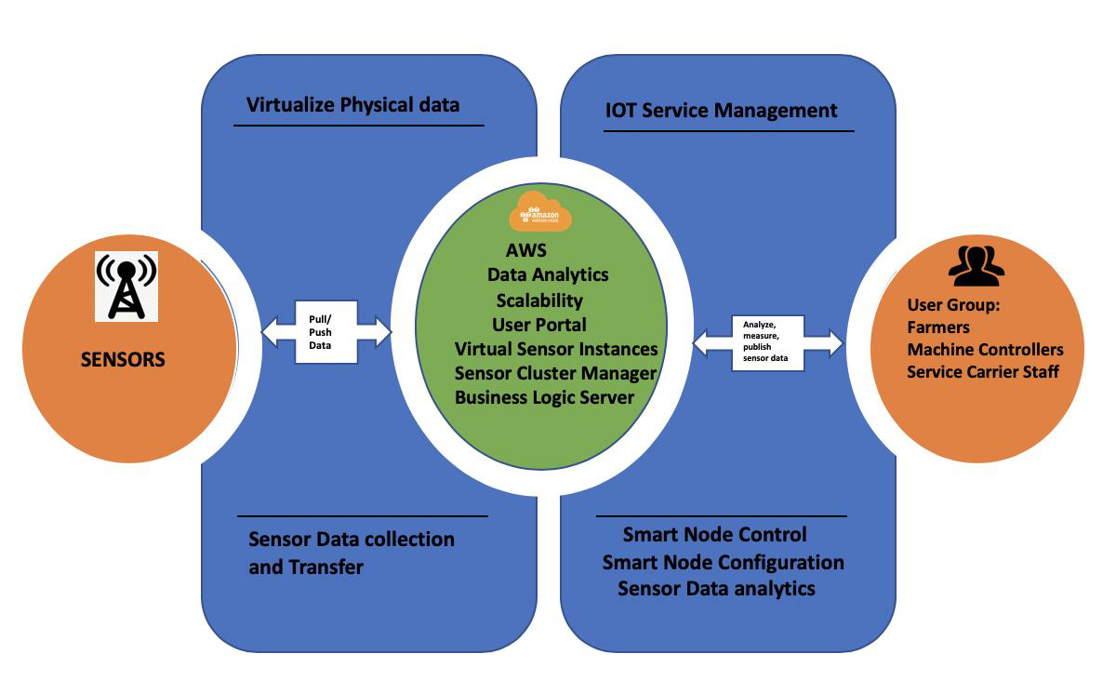
System Infrastructure Design
Sensor layer - Sensor data
collection and transfer.
AWS based cloud layer -
interface between the sensors
and the user group.
User Group layer: Monitor
and track the status of sensors.

Slide 8
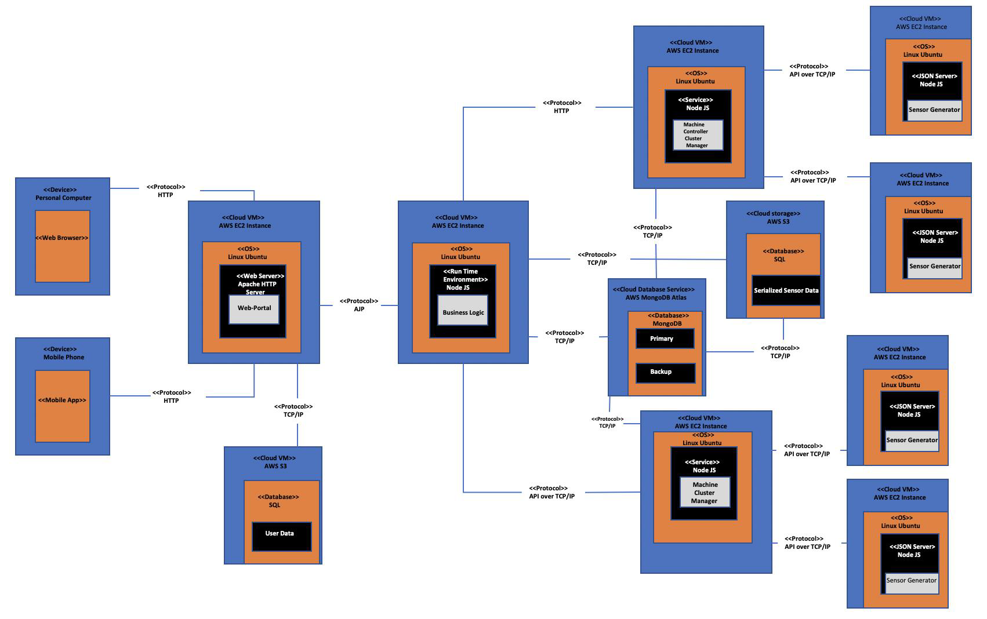
System Deployment Diagram

Slide 9
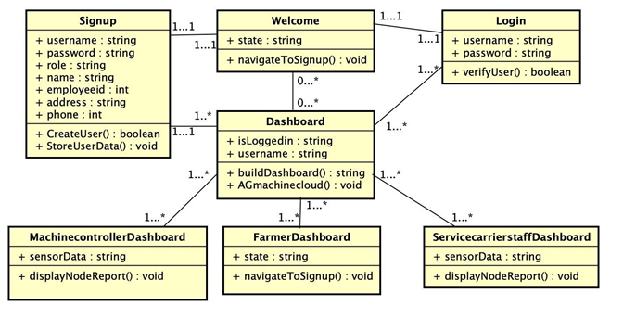
Database Class diagram

Slide 10
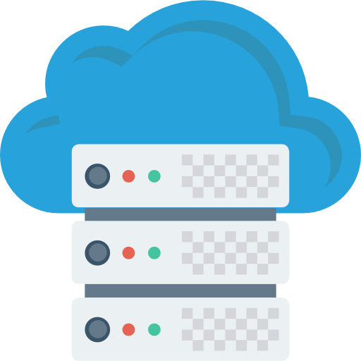
Database Engineering
Sensor data collected in a MongoDB.
DB connected to Business Logic Server and Cluster Manager.
Location Hierarchy.
Time series Hierarchy.

Slide 11
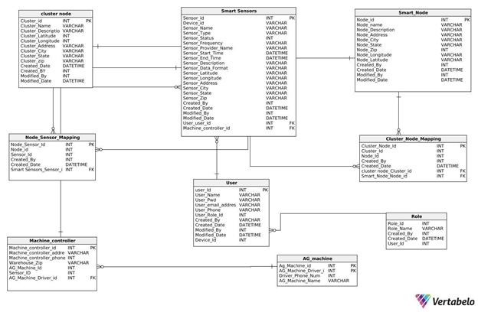
Database Design

Slide 12
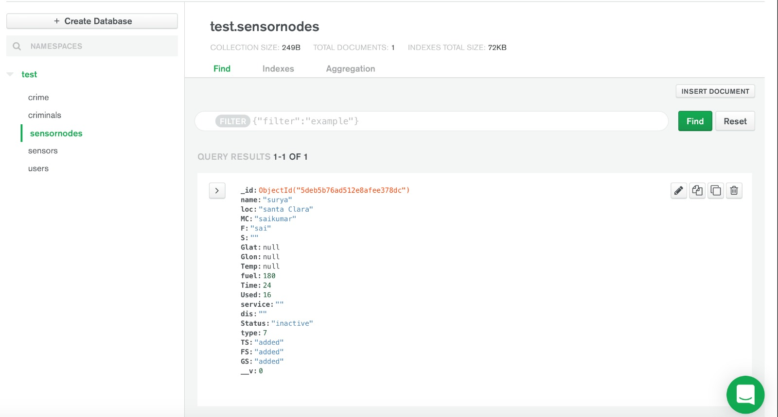
Data in MongoDB Atlas

Slide 13
Technologies used
FRONTEND
BACKEND
DATABASE
VISUALIZATION
HTML
CSS
BOOTSTRAP
NODE JS
EXPRESS JS
MONGODB
High charts

Slide 14
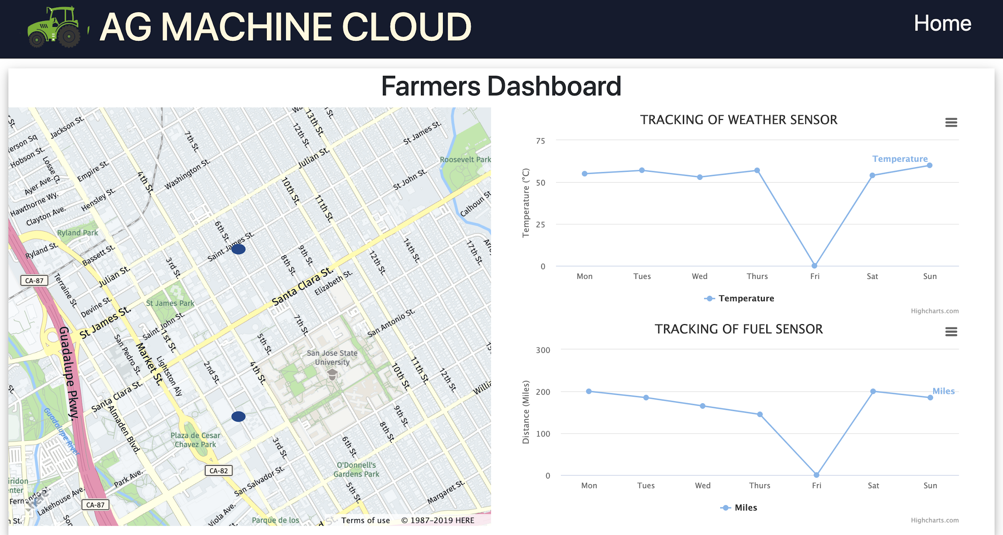
Dashboard

Slide 15
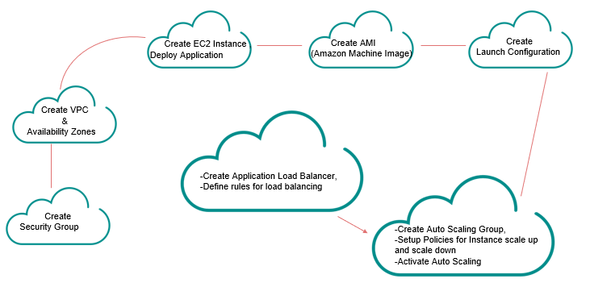
AWS Set Up - Approach

Slide 16
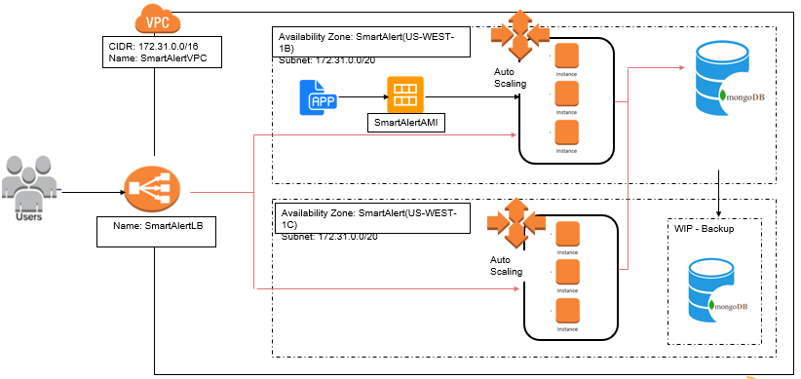
AWS Set Up - Architecture

Slide 17
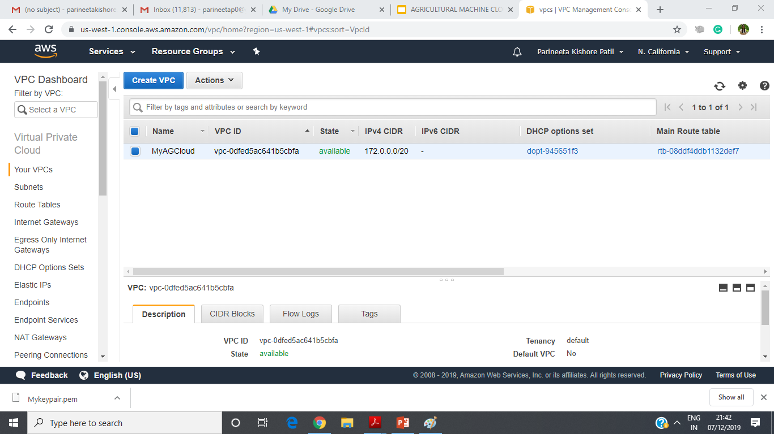
VPC and Availability Zones

Slide 18
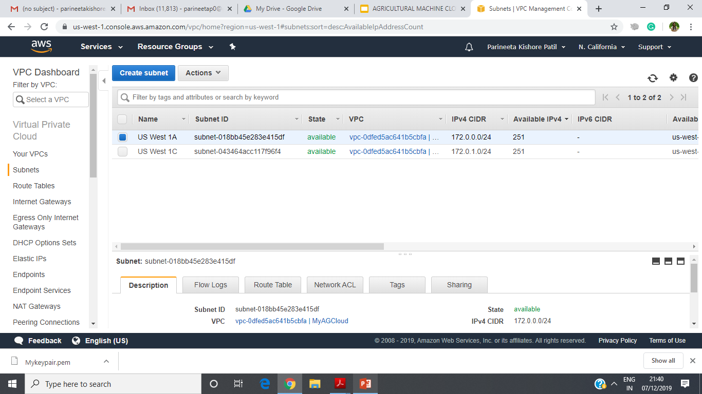
VPC and Availability Zones

Slide 19
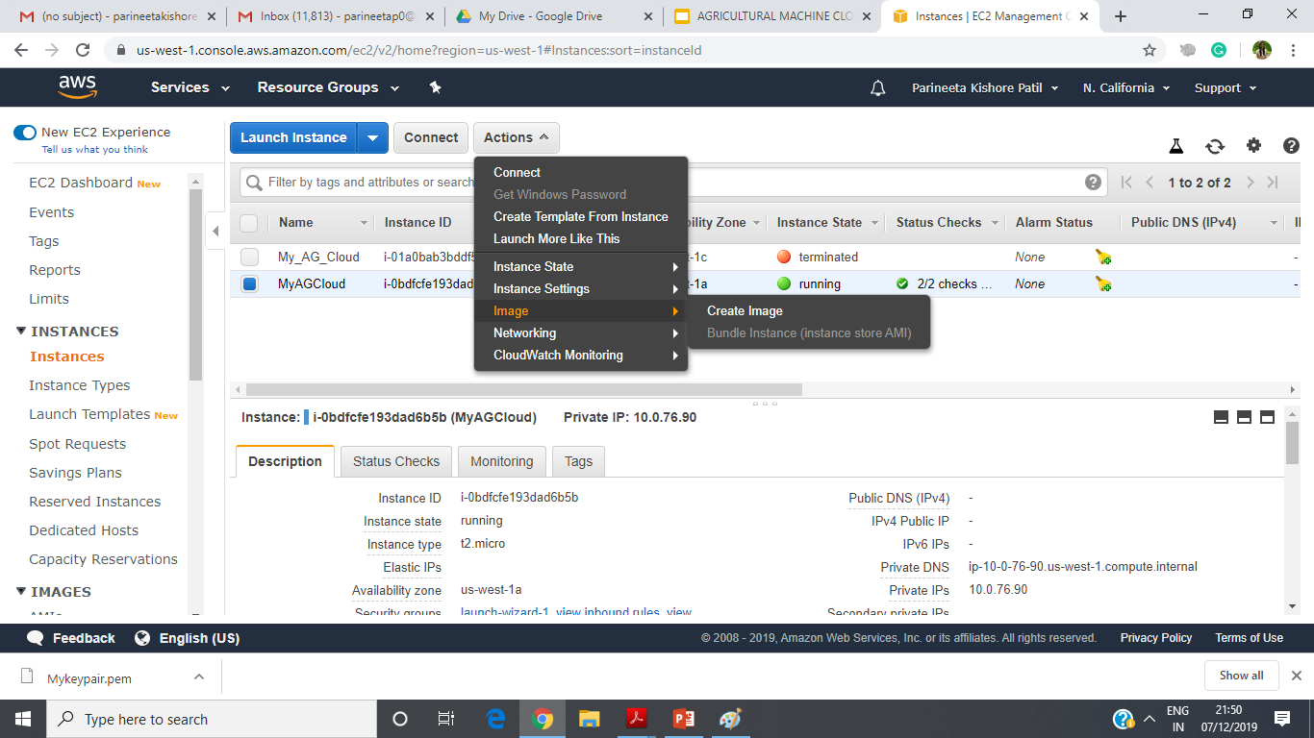
Amazon Machine Image

Slide 20
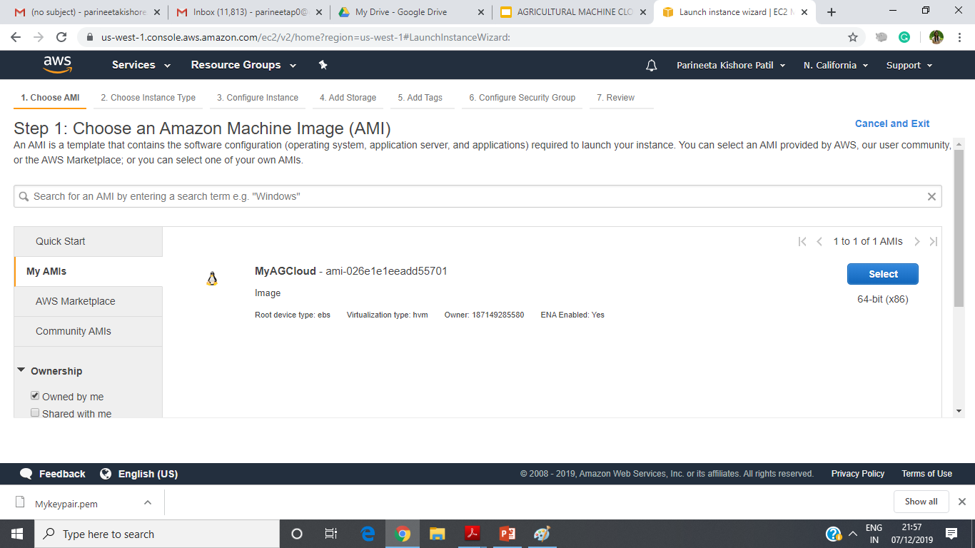
AWS Launch Configuration

Slide 21
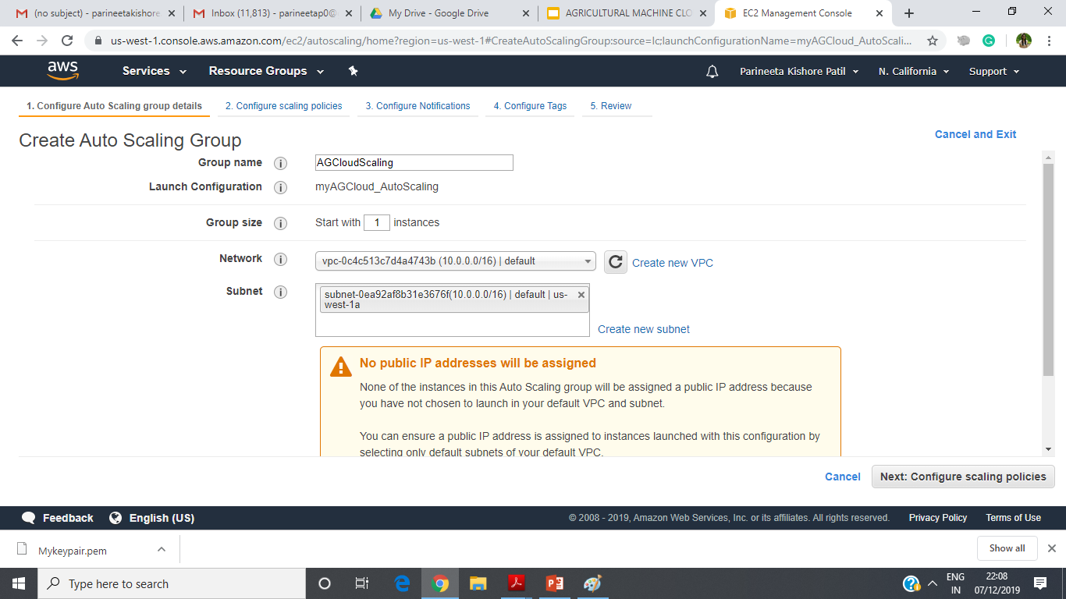
AWS Auto Scaling - Setup

Slide 22
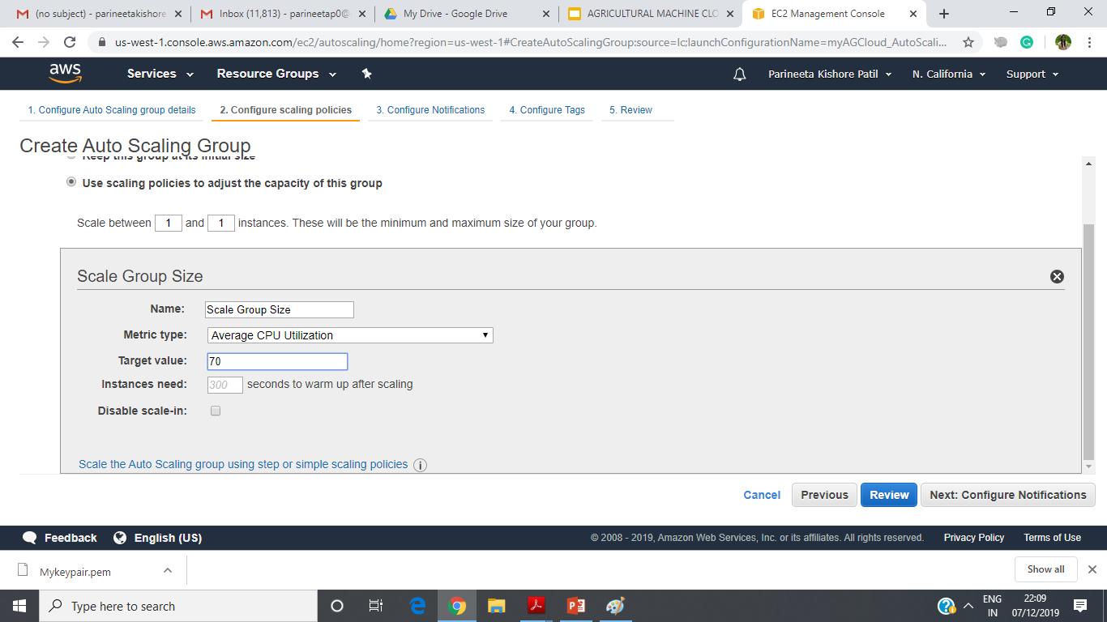
AWS Auto Scaling - Policies

Slide 23
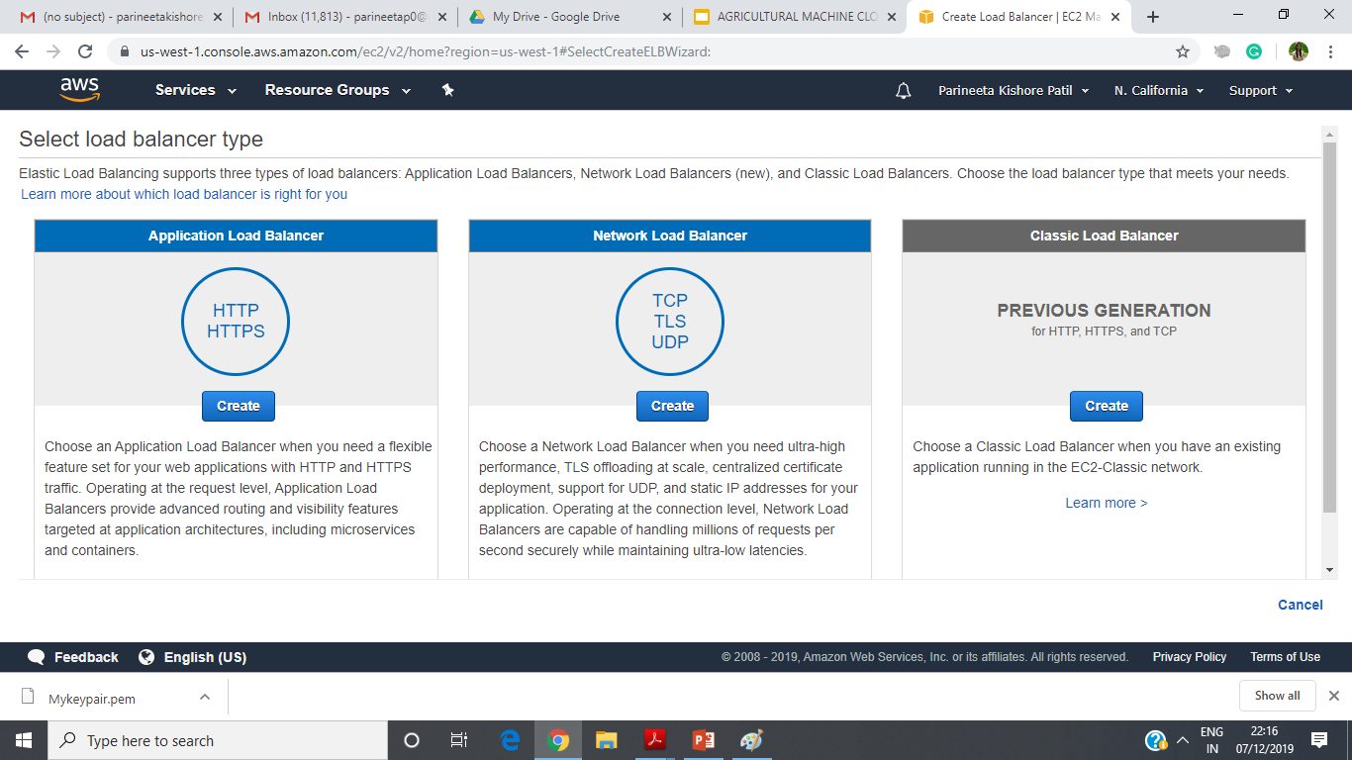
AWS Load Balancer Setup

Slide 24
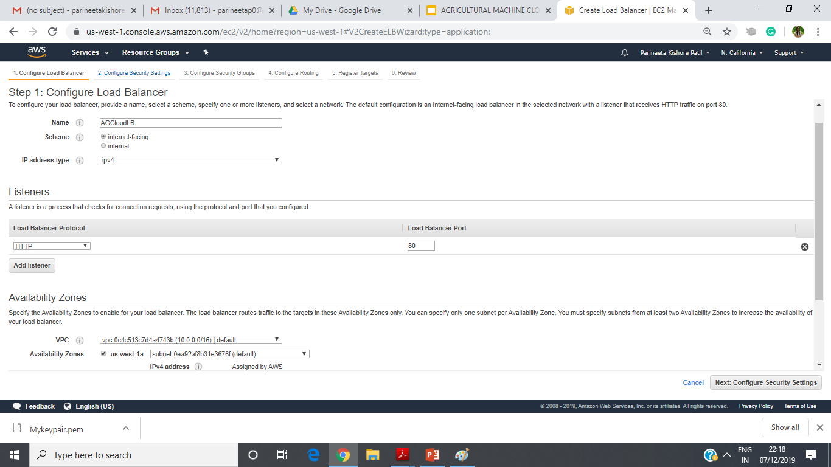
AWS Architecure Setup

Slide 25
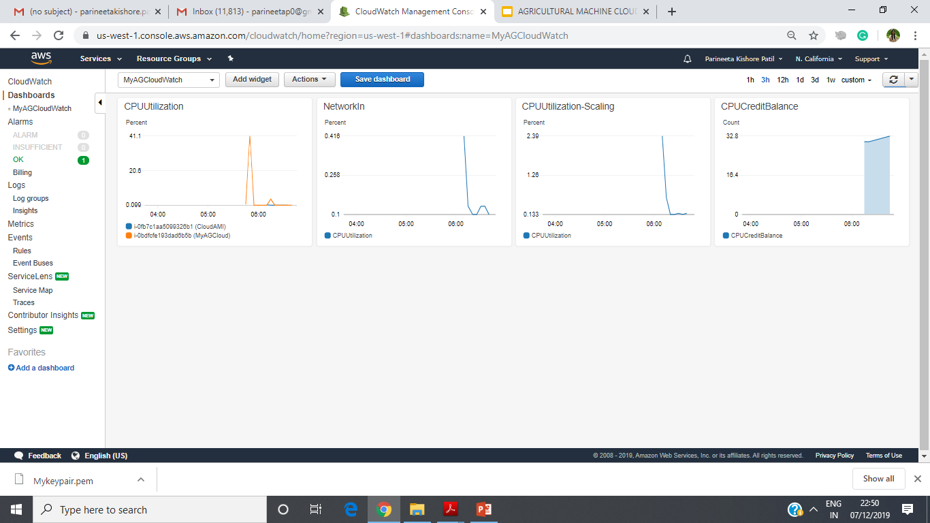
AWS CloudWatch

Slide 26
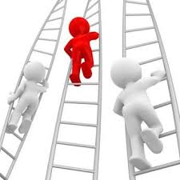
Future Enhancement
More accurate sensor tracking.
Machine Learning advancement.
Implementing android application.

Slide 27


